Slide 1

Intro to
Presented by Kaki Su

Slide 2


What is scrapy?
web crawling framework
extracts data from web pages
Notes:
Scrapy is a fast, web-crawling framework written in Python. It is used to extract structured data from web pages. This extracted data can be used for a wide range of useful applications, like data mining, information processing, or historical archival.

Slide 3

Some cool features
Automatically handles errors
Automatically logs in into pages that you need an account
Multiple requests at a time
Can scrape images too
Notes:
-You will often find when scraping that web you will come across a lot of errors. pages won’t be found, servers will have errors or you could have internet connectivity issues half way through a large scrape. Scrapy lets you handle errors gracefully and even has inbuilt ability for resuming a scrape from the last page it encountered.
-Some websites will be behind a login wall. Scrapy has built in form handling which you can setup to login to the websites before beginning your scrape.

Slide 4
Pros and cons
pros
cons
Faster than other scraping tools
Easily extensible
Does not take up much space in CPU
A lot of resources
Works on many platforms
Not as beginner friendly. Not as easy to start scraping
Notes:
-extensible…provides several mechanisms to plug new code without having to touch the framework core
-many working examples that you can use
-works with windows, mac, etc.

Slide 5

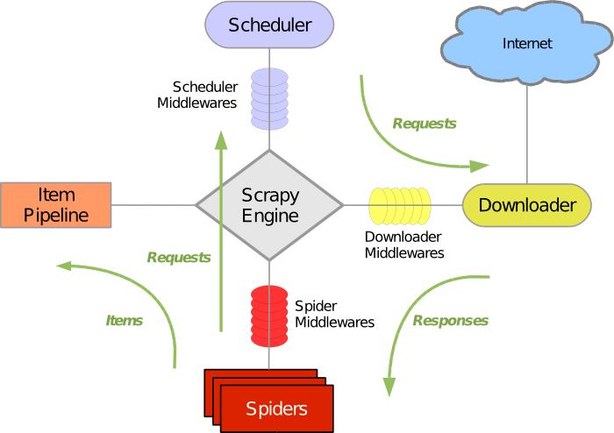
Scrapy architecture
Notes:
You have Spiders, which are responsible for crawling sites. From the Spiders, the engine gets information on where (what URL) to look, and schedules them in the scheduler. The Engine then sends that info to the downloader which is connected to the Internet, and the downloader will send back the responses. Then the engine will send the data to the Spiders and have them process it.

Slide 6
How do we crawl the web?

Slide 7
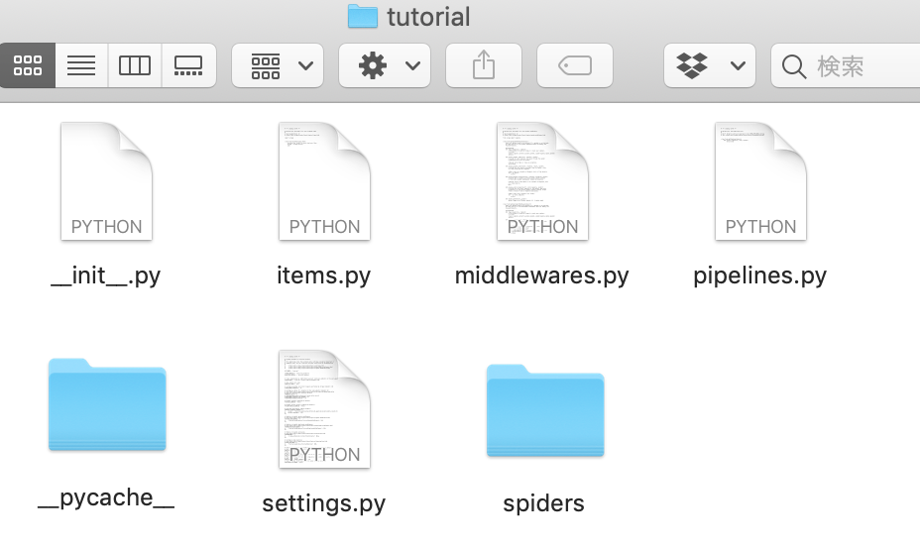
CREATING A PROJECT

Slide 8
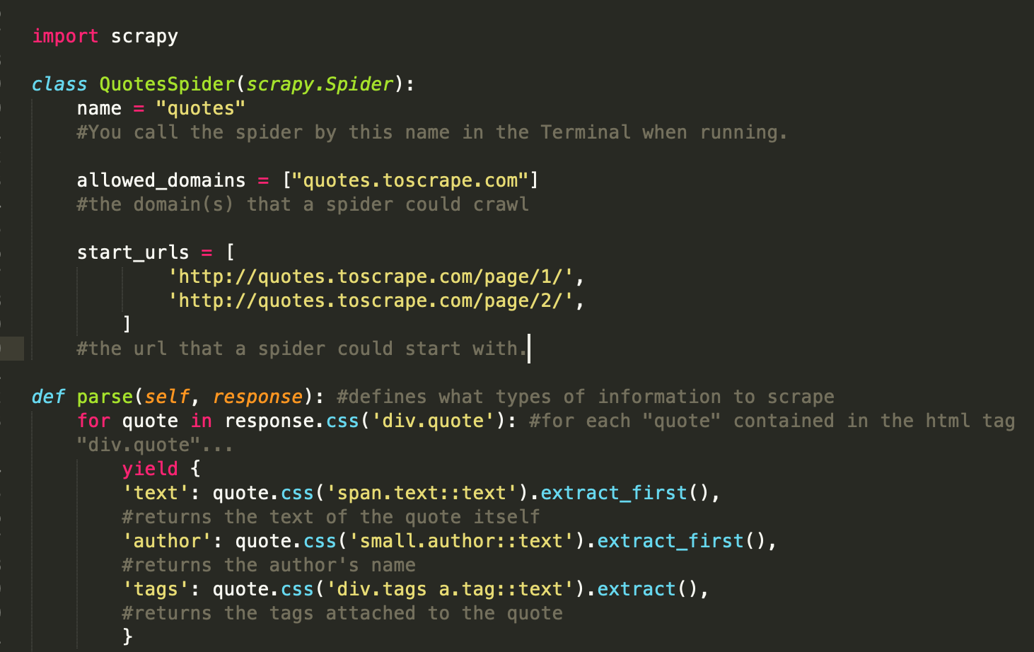

Spiders
scrapes information from one or more websites.
Notes:
Spiders in Scrapy are classes that you define, from which Scrapy uses to scrape information from one or more websites.
Name…Identifies the Spider. Must be unique within a project—you can’t set the same name for different Spiders.
Allowed domains…List of domains on which the spider can crawl
Start.. a list of URLs, which will be the roots for later crawls, where the spider will begin to crawl from.
parse ()… This method processes the response and returns scrapped data that the user instructs

Slide 9
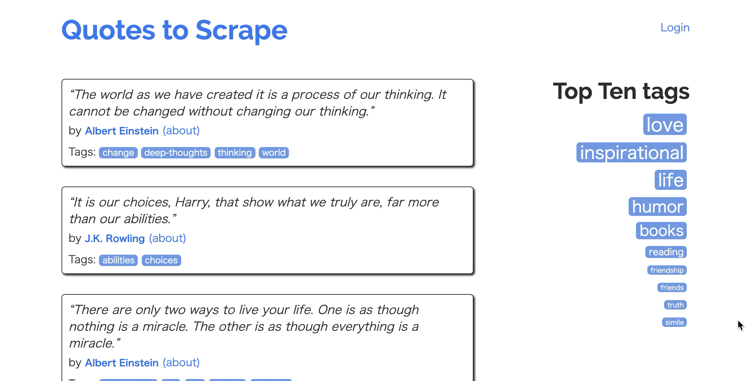
Quotes.toscrape.com

Slide 10
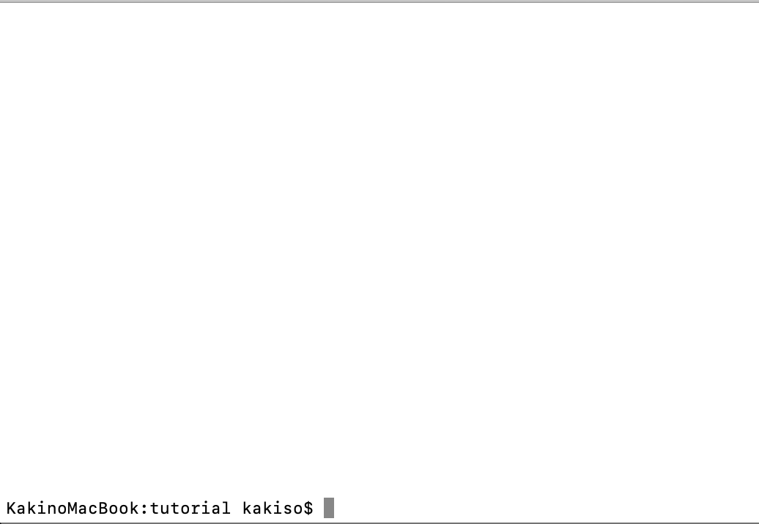
Running the spider

Slide 11
Selecting information to extract

Slide 12
Identifying the html code
Hypertext Markup Language
Instructs a web browser how to display things
Notes:
HTML (Hypertext Markup Language) ...a text-based approach to describing how content contained within an HTML file is structured. This markup tells a web browser how to display the text, images and other forms of multimedia on a webpage.
You can get this information from your browser from developer tools or similar tabs.
You can see that the quotes are contained in the class “quote” and the author’s name is an element of the class “author”.

Slide 13
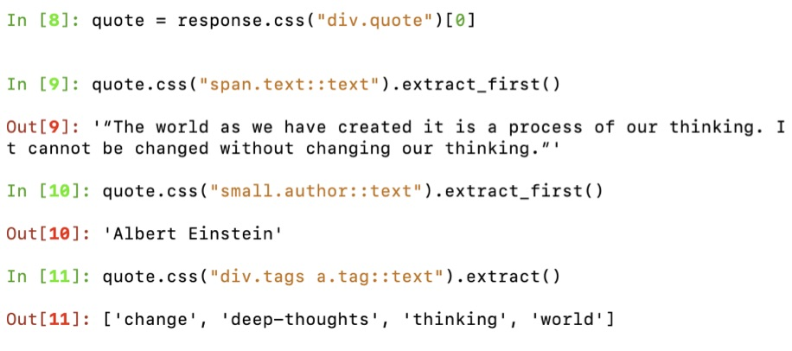
Selector
A rule set that tells the browser what elements to ‘select’ for styling.
Notes:
For extracting data from web pages, Scrapy uses a technique called selectors based on XPath and CSS expressions.
Even though XPath is more extensive and comprehensive in its expression, we are going to use CSS because it is more intuitive and easier for beginners.

Slide 14
Notes:
Again, you can see how the selector instruction is incorporated into the parse method in the spider

Slide 15
storing the data

Slide 16
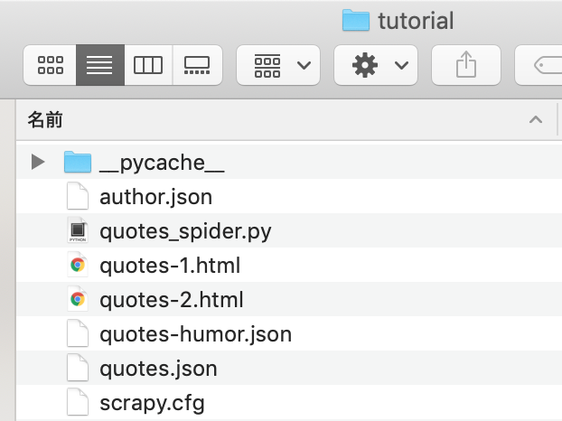
Using json files
an open-standard file format that uses human-readable text to transmit data objects
How? Just add:
“-o (filename).json” when you run your spider in the Terminal

Slide 17
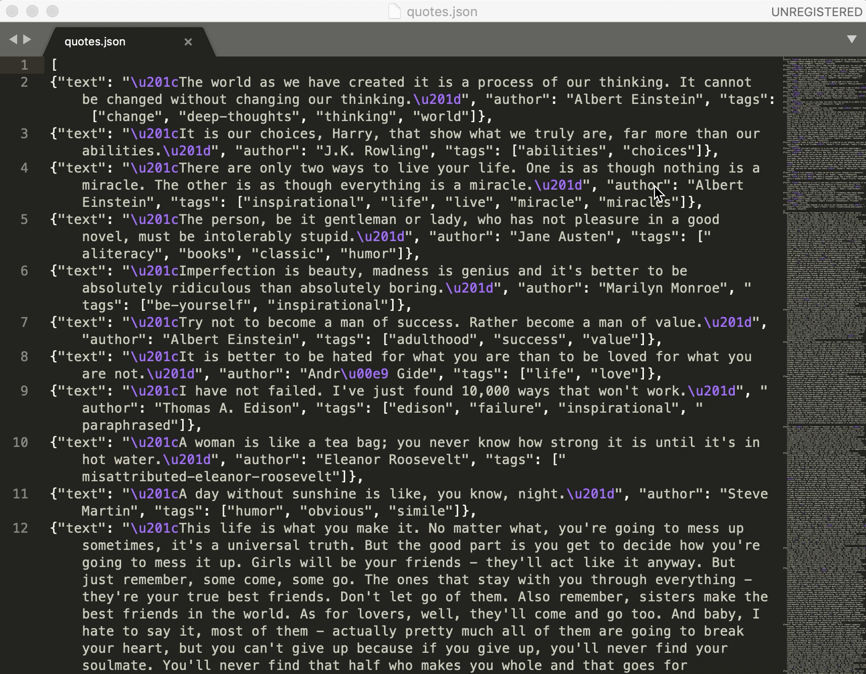

Slide 18


Other things you can do
Recursively following links
Scraping google books, Instagram, Youtube
Give ore specific commands
Format data storage different according to different needs
Notes:
-from a specific tag
-csv format

